Slide 1

Water Regulatory Developments and the Board’s Role Amid Evolving Federal and State Priorities
Illinois Pollution
Control Board Member
Mike Mankowski
IERG Water Seminar September 9, 2025

Slide 2

Agenda
Structure of the Board and Staff
Rulemaking Process Before the Board
PFAS Update
Other regulatory updates
Navigating the changing federal environmental landscape

Slide 3

Structure of the Board and staff

Slide 4
Structure of the Board
5 BOARD MEMBERS
Appointed by Governor
Confirmed by Senate
3-year term
Bipartisan
Each Member has verifiable technical, academic, or actual experience in the field of pollution control or environmental law and regulation

Slide 5

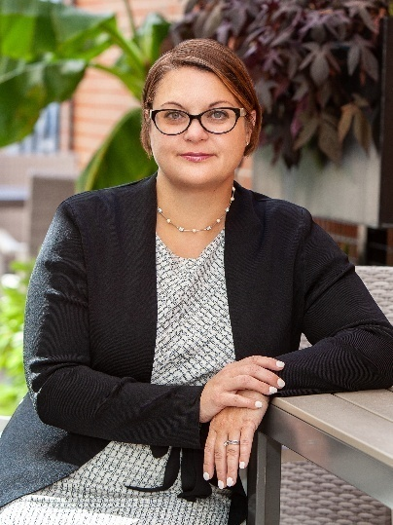
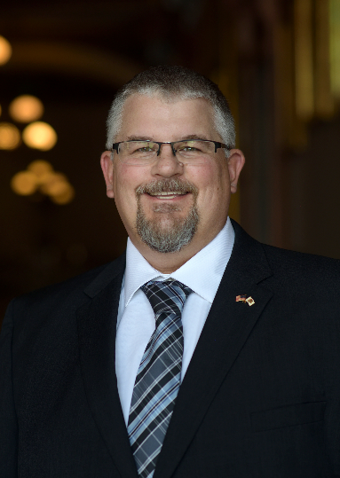

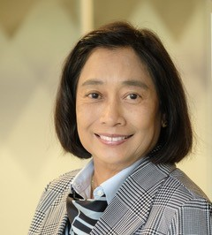
CURRENT BOARD MEMBERS
CHAIR BARBARA FLYNN CURRIE
BOARD MEMBER JENNIFER A. VAN WIE
BOARD MEMBER MICHAEL D. MANKOWSKI
BOARD MEMBER MICHELLE GIBSON
BOARD MEMBER ANGELA TIN

Slide 6
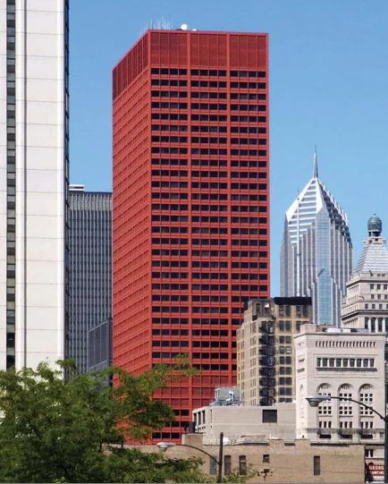
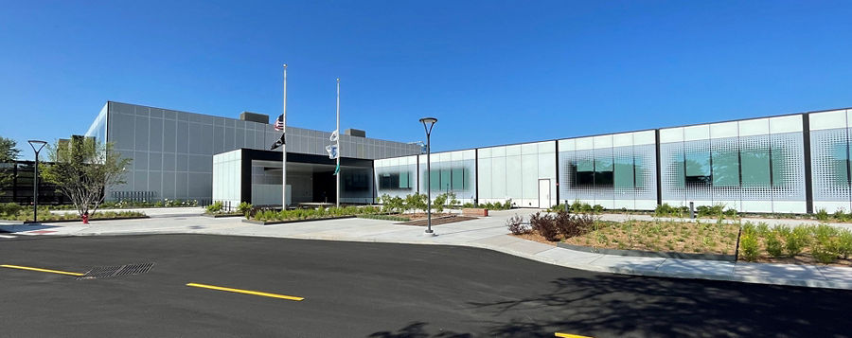
the Board Staff

Slide 7
Board Staff
General Counsel – Marie Tipsord
Staff Attorneys (6)
  Research & Writing, Hearing Officers, and Legislative Liaison
  IIS Attorney
Attorney Advisors (5)
  Assist Board Members
Technical Unit
  Anand Rao – Chief Environmental Scientist
  Essence Brown – Environmental Scientist
Administrative Staff (6)
  Board Clerk, Fiscal, IT, and Administrative Support Staff

Slide 8


Technical Unit Staff
Anand Rao
Chief Environmental Scientist
Joined the Board in 1989
MS Environmental Engineering, Marquette University
BS in Civil Engineering, Bangalore University
Essence Brown
Chief Environmental Scientist
Joined the Board in 2019
MPH in Environmental Health from University of Illinois at Chicago
BS in Biomedical Sciences w/minor in Chemistry from Southern Illinois University Carbondale

Slide 9
Technical Unit Staff Duties
  Provide scientific and technical consultation to all Board Members regarding the Board’s regulatory and adjudicatory proceedings, decisions, and policies to ensure sound science.
  Advise the Board’s General Counsel and Senior Attorneys on all scientific and technical issues concerning cases before the Board, as well as relevant legislative and appellate matters.
  Over the last 30+ years, Mr. Rao and Technical Unit staff have provided technical guidance to numerous Board Chairs, Members, and attorneys on all pollution control rulemakings, including comprehensive regulation of solid waste landfills, surface and ground water quality, air quality, noise, medical waste, and environmental remediation. They have also provided considerable technical perspective on adjudicatory cases touching on all areas of the Board’s authority.

Slide 10
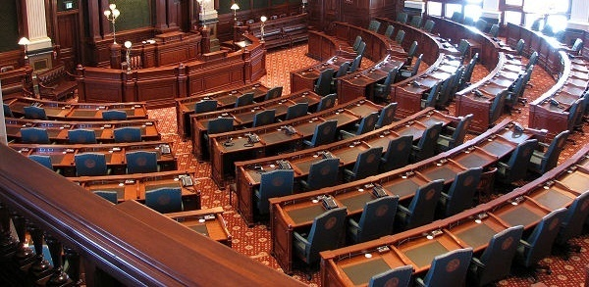
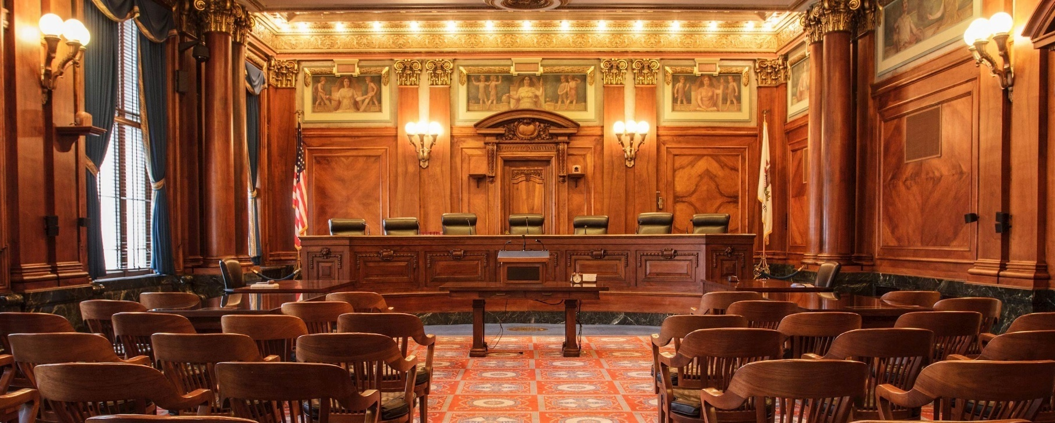
BOARD FUNCTIONS
QUASI-LEGISLATIVE (RULEMAKING)
QUASI-JUDICIAL (ADJUDICATIONS)

Slide 11
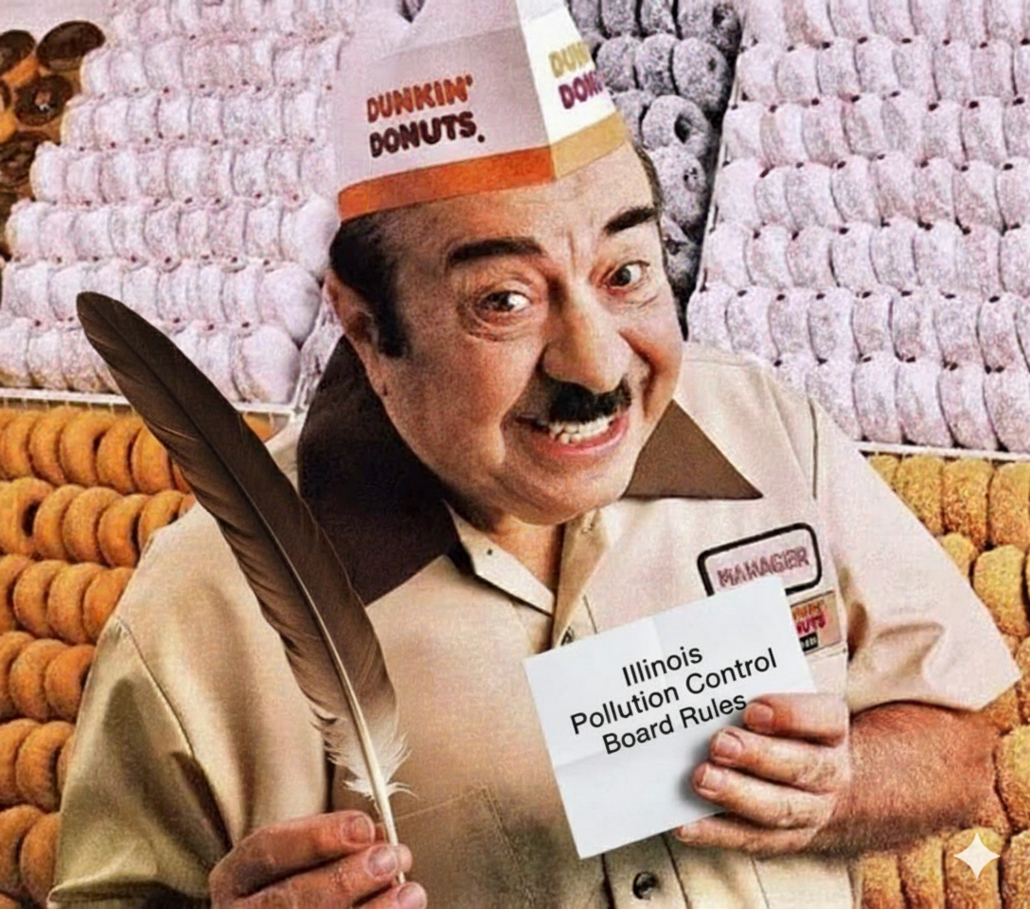
Time to Make the Rules!

Slide 12

What is a rulemaking?
How the Board adopts, amends, or repeals environmental regulations.
The Illinois Environmental Protection Act (the “Act”) – 415 ILCS 5/26-29
The Illinois Administrative Code (the “Rules”) – 35 Ill. Adm. Code Part 102
The Illinois Administrative Procedure Act – 5 ILCS 100/5-5, et seq.

Slide 13

Who can propose rules?
The Board: in reaction to State or federal laws
The Illinois Environmental Protection Agency: may be directed by legislation
Individuals, associations, citizen groups, units of local government, and companies

Slide 14
Process for a general rulemaking
Proposal filed
Second Notice
Board accepts proposal and holds hearings
First Notice
Final Adoption
Effective Date

Slide 15
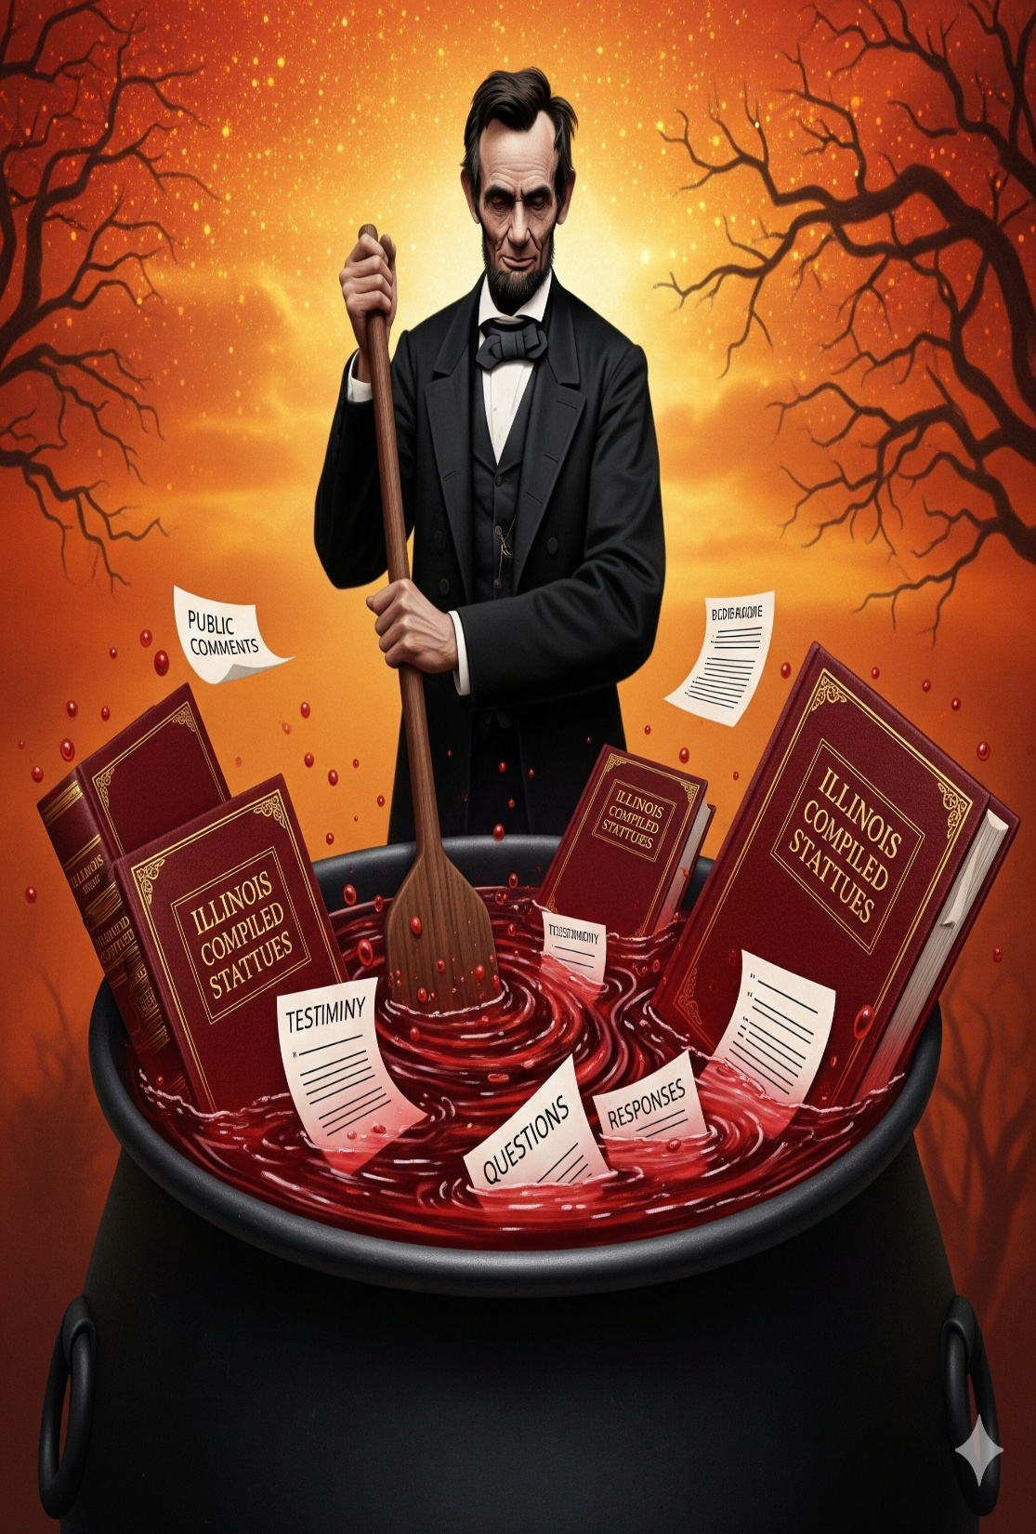
Rulemaking Proposals
Subpart B of Part 102 of the Board’s Rules addresses the requirements of a rulemaking proposal.
Any person may submit a regulatory proposal for the adoption, amendment, or repeal of a regulation. 35 Ill. Adm. Code 102.200
Proposals must be filed with the Clerk and served upon the Attorney General, the Illinois EPA, and DNR. 35 Ill. Adm. Code 102.200

Slide 16
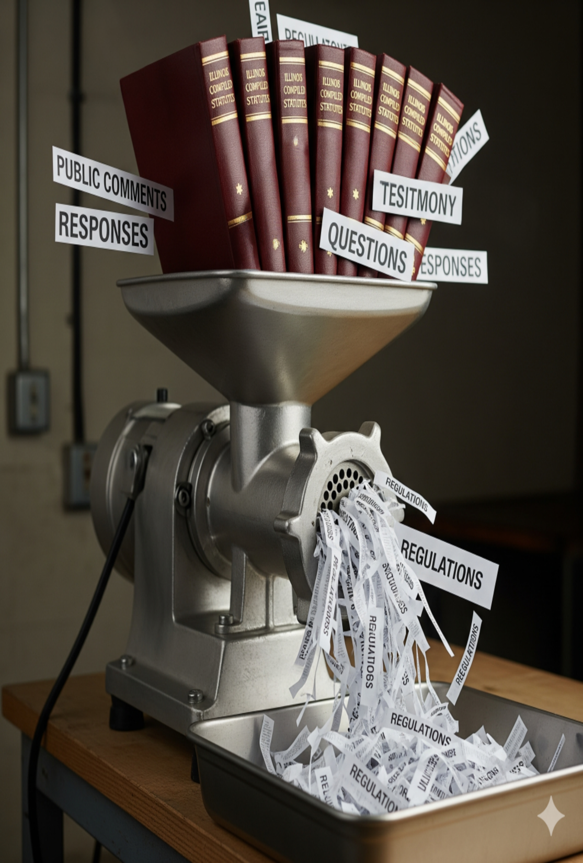
Rulemaking Proposals
Section 102.202 addresses the required contents for regulations of general applicability.
  The language of the proposed rule, including any existing regulatory language proposed to be amended or repealed.
  A statement of the reasons supporting the proposal
  A synopsis of all testimony to be presented by the proponent at hearing
  IAPA required materials
  Information related to any published studies or research reports used in developing the rule
  Proof of Service
  Petition with 200 signatures
  Electronic version of the proposed language

Slide 17

Rulemaking Proposals
Sections 102.204 through 102.211 address other types of proposals:
  102.204 Proposal of RCRA Amendments
  102.206 Notice of Site-Specific RCRA Proposals
  102.208 Proposal for Site-Specific Regulations
  102.210 Proposal Contents for Site-Specific Regulations
  102.211 Proposal to Update Incorporations by Reference

Slide 18
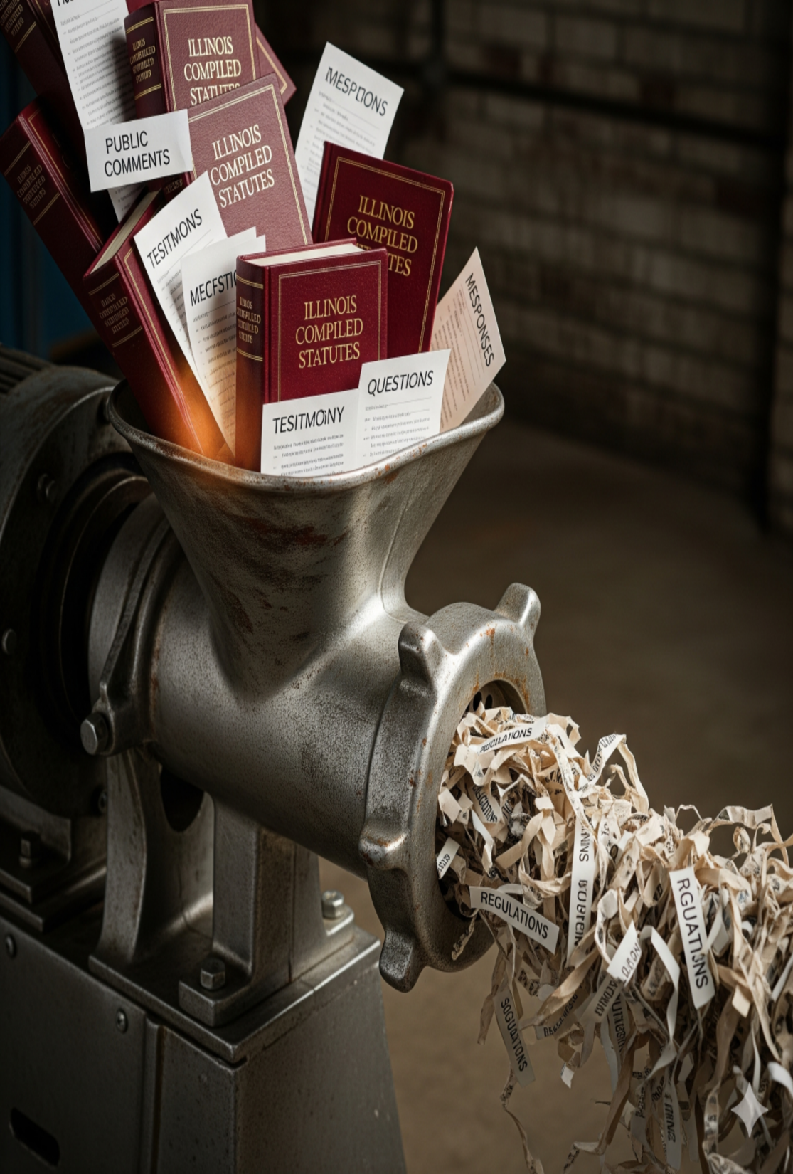
Rulemaking Proposals
Dismissal of Rulemaking Proposals
  Section 102.212 lists reasons why a proposal may be dismissed for reasons such as:
    Failure to satisfy the content requirements
    Failure to Board requests for additional information
    Failure to pursue disposition of the proposal in a timely manner
    Board cannot determine the statutory authority on which the proposal is made

Slide 19
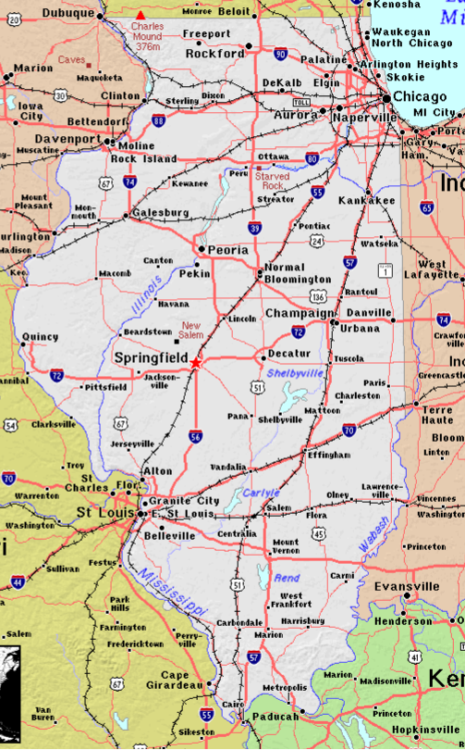
Hearings
A rulemaking of state-wide applicability must receive two hearings, to be held in different parts of the State.
  415 ILCS 5/28(a)
  35 Ill. Adm. Code 102.416(a)(2)

Slide 20

First notice
Board can make revisions, then issue opinion and order adopting the regulation
Publication in the Illinois Register
Publication begins 45-day-minimum public comment period
  35 Ill. Adm. Code 102.604
  5 ILCS 100/5-40

Slide 21
second notice
Board can make revisions, then issue opinion and order adopting the regulation
The second-notice period lasts 45 days
During this time, the Joint Committee on Administrative Rules (JCAR) reviews the rules
No further substantive changes may be made
  35 Ill. Adm. Code 102.606
  5 ILCS 100/5-40

Slide 22
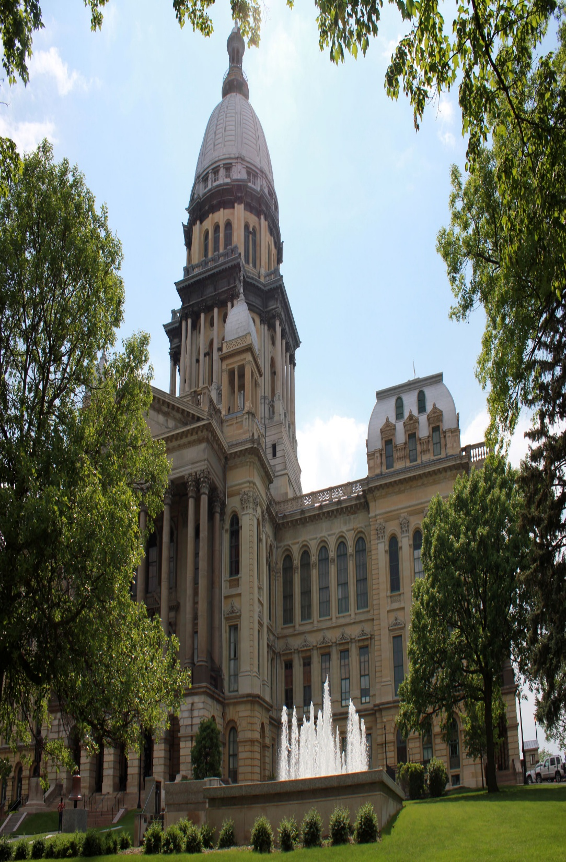
Possible actions by JCAR
Certificate of No Objection
  the Agency can adopt with no changes
Objection
  Requires Agency response within 90 days
  An Agency can modify, withdraw, or adopt rules (even over objection)
Recommendation
  Requires Agency response within 30 days
  An Agency can modify or withdraw, refuse, or follow recommendation
Filing Prohibition
  JCAR determines that rule constitutes a threat to the public interest, safety or welfare
  Rule cannot be accepted by the SOS unless modified

Slide 23
FINAL ADOPTION
Board can issue an opinion and order
Board files the regulation with the Secretary of State
Regulation is effective upon filing unless specified otherwise
Publication in the Illinois Register
  35 Ill. Adm. Code 102.608
  5 ILCS 100/5-40

Slide 24

IS THIS HOW ALL RULES ARE ADOPTED? no
IDENTICAL-IN-SUBSTANCE
  415 ILCS 5/7.2, 13.3, 28.2, 28.4
  No hearings are held
FEDERALLY REQUIRED
  415 ILCS 5/28.2
  Any objections must be filed within 21 days after accepts for hearing order
CLEAN AIR ACT FAST-TRACK
  415 ILCS 5/28.5; 35 Ill. Adm. Code 102.300 et seq.
  Generally, must be completed within 180 days

Slide 25

Statutory deadline rules
The IEPA may file rules that have a deadline mandated by statute
Deadline may be a date certain
  Clean construction or demolition debris (R06-19)
  Public Act 94-272 requires the Board to adopt rules no later than September 1, 2006.
Deadline may also be a certain number of days
  Community right-to-know (R06-23)
  Public Act 94-314 requires the Board to adopt rules within 240 days of the effective date of P.A. 94-314, or no later than September 17, 2006.

Slide 26

EX PARTE COMMUNICATIONS
This is where the Board rulemaking process differs from the General Assembly legislative process
Board Members may not be lobbied
ANY ex parte communications must be made part of the record
  35 Ill. Adm. Code 101.202
  35 Ill. Adm. Code 101.114(c)

Slide 27

PUBLIC PARTICIPATION
How to influence a rulemaking

Slide 28

What can you influence?
Minimum Time to Complete
Record of Proceeding
Board’s Decision

Slide 29
Levels of Participation
Monitor
Notice List
Service List
Proponent

Slide 30
Tips for successful advocacy
Get involved early
File public comment and provide support for position
  Serve everyone on the service list
  Clear, well-supported technical arguments are helpful
  This is your opportunity to get your message to the Board, don’t waste it
Appear at hearing and be available for questioning
  Prefile testimony
    Written testimony given same weight as oral
    Oral testimony can help give color to written testimony
Suggest rule language
Don’t forget to consider economic impact and technical feasibility

Slide 31

Amendments to groundwater quality
35 Ill. Adm. Code 620 r 22-18

Slide 32
part 620 rulemaking (R 22-18)
On March 20, 2025, the Board adopted final amendments to its groundwater quality rules at 35 Ill. Adm. Code 620.
Before final adoption, the Board:
  Held 3 public hearings
  Admitted 33 hearing exhibits
  Received and Reviewed 81 public comments
  Issued opinions and orders at First Notice, Proposed Second Notice, and Second Notice.

Slide 33
part 620 rulemaking (R 22-18)
The amendments took effect on March 28, 2025.
They established numerical groundwater quality standards for new constituents that have been detected in Illinois groundwater, including six per- and polyfluoroalkyl substances also known as PFAS.
  Perfluorooctanoic acid (PFOA)
  Perfluorooctanesulfonic acid (PFOS)
  Perfluorononanoic acid (PFNA)
  Perfluorohexanesulfonic acid (PFHxS)
  Perfluorobutanesulfonic acid (PFBS)
  Hexafluoropropylene oxide dimer acid (HFPO-DA or GenX)
  Molybdenum
  Lithium
  Aluminum
  1-methylnaphthalene
  Three new atrazine metabolites whose concentrations are combined with atrazine when determining compliance

Slide 34
part 620 rulemaking (R 22-18)
Along with these new groundwater quality standards, the Part 620 amendments:
  Updated existing Class I and Class II standards for 47 chemical constituents;
  Added site-specific groundwater standards for designated Class III Special Resource Groundwater;
  Updated groundwater management zone (GMZ) requirements;
  Update exposure factors used for calculating Human Threshold Toxicant Advisory Concentrations (health-based guidance levels for non-carcinogens);
  Update methods for calculating Human Nonthreshold Toxicant Advisory Concentrations (health-based guidance levels for carcinogens), including a separate calculation for chemicals that are listed as mutagens;

Slide 35
part 620 rulemaking (R 22-18)
Along with the new groundwater quality standards, the Part 620 amendments:
  Added tables listing similar-acting chemicals for assessing mixtures of contaminants in the groundwater;
  Updated procedures for determining Class I groundwater;
  Updated definitions, incorporations by reference, and analytical requirements;

Slide 36
part 620 rulemaking (R 22-18)A Subdocket
  The amendments established in 620.410(f) that facilities subject to Part 811 or 814 are not required to comply with the Part 620.410 standards for HFPO-DA, PFBS, PFHxS, PFNA, PFOA, or PFOS.
  At Second Notice, the Board opened a sub-docket to explore the economic impacts to Part 811 and 814 landfills to comply with these new standards.
  The Board exempted those landfills while it conducts hearings and receives testimony on that issue.
  There is an upcoming hearing on September 16th in Chicago and Springfield for anyone who would like to attend.
    NOTE: PART 807 Landfills are NOT EXEMPT from the Part 620 amendments.

Slide 37
IERG PFAS Questions
o What will the Board do if in certain parts of the state there is a known groundwater plume that exceeds the standard?
o How will the Board manage adjusted standards for PFAS in groundwater?

Slide 38
Adjusted Standards
Board may grant petitioners individual alternative standards
Must demonstrate specific factors as set out in Section 28.1 or specific rules
Factors relating to that petitioner are substantially/significantly different from factors relied upon by the Board when adopting general regulation
Existence of those factors justifies an adjusted standard
The adjusted standard will not result in environmental or health effects significantly more adverse than would occur under generally applicable regulation
Consistent with federal law
Board may grant subject to conditions

Slide 39
Variances
Temporary relief from an environmental regulation (limited to 5 year increments)
Pollution source must prove that complying with regulation would “impose an arbitrary or unreasonable hardship”
However, Board is not required to find that arbitrary hardship exists exclusively because the regulatory standard is under review and the cost of compliance is substantial and certain.
Must include a plan to come into compliance with the rules.
Board may grant subject to conditions

Slide 40
Other Water regulatory updates
Name | Docket No. | Status | Board Member(s)
Electric Energy, Inc. Interim Adjusted Standard | AS 21-5 | Order Issued | Mankowski
INEOS Alternate Thermal Effluent Limitations | PCB 23-135 | Order Issued | Mankowski
IIS SDWA PFAS Update | R25-1/25-9 | Deadline Extended | Gibson
IIS Wastewater Pretreatment Update for Steam Electrical Power Generating Sources | R25-6 | Order Issued | Mankowski

Slide 41
Navigating the Changing federal environmental landscape
Federal statutes and regulations set floor for environmental compliance. States can do more.
Identical-in-substance regulations
Attorney General and Illinois EPA are front lines in responding to direct federal actions aimed at environmental rollbacks, along with the General Assembly.
Board has authority to initiate rulemaking on its own but rarely used.

Slide 42

Thank you!
Mike Mankowski
Board Member, IPCB
Pcb.Illinois.gov

