Slide 1
PFAS Reduction Initiative for Wastewater Dischargers
Keegan MacDonna, P.E.
Environmental Protection Engineer
Division of Water Pollution Control, Permit Section

Slide 2
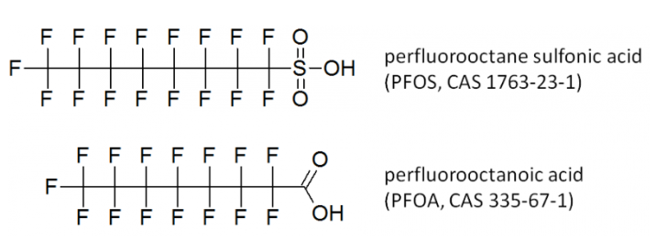
What is PFAS?
Perfluoroalkyl and polyfluoroalkyl substances (together known as PFAS) are manmade chemicals consisting of chains of carbon atoms bonded with fluorine atoms, with characteristics dependent on the composition of atoms at the end(s) of the chain.
Common uses of PFAS compounds:
  Non-stick cookware and utensils
  Stain resistant fabrics
  Fire retardants
  Food packaging
  Personal care products

Slide 3
Environmental Impacts of PFAS
According to USEPA, exposure to certain levels of PFAS may lead to:
Increased risk of some cancers
Developmental defects or delays in children
Reproductive effects such as decreased fertility or increased blood pressure in pregnant women
Accumulation of PFAS:
PFAS compounds can take hundreds or thousand of years to break down due to the strength of the carbon-fluorine bonds in their chemical structures.
Referred to by some as “forever chemicals”

Slide 4
Illinois EPA’s Approach to Reduction of PFAS in Wastewater Discharges
NPDES Permits
Quarterly discharge monitoring requirements
Development of Best Management Practices (BMPs) to reduce PFAS concentrations in wastewater
Targeted approach based on facility industrial classification
PFAS reduction conditions applied in 61 NPDES permits so far
State Construction and Operating Permits
Monitoring and BMP requirements for targeted industries, for discharges to smaller POTWs
Adoption of new groundwater standards promulgated by the Illinois Pollution Control Board
Permitting of treatment systems designed for removal of PFAS

Slide 5
NPDES Permitting – PFAS Monitoring
Targeted approach to implementation of PFAS monitoring requirements
Major Municipal and Industrial NPDES permits
Industrial facilities with SIC codes associated with PFAS presence in wastewater
Other facilities with potential to discharge wastewaters with PFAS
  Solid waste treatment, storage, and disposal facilities
  Firefighting training facilities
  Airports
  Other known or expected sources of PFAS

Slide 6
NPDES Permitting – PFAS Monitoring
Quarterly monitoring of PFAS compounds
Requires USEPA Method 1633A (currently Revision A, published December 2024)
  Utilizes liquid chromatography/mass spectrometry for analysis of aqueous, solid, and/or tissue samples
  Returns concentrations of 40 PFAS compounds, including PFOS and PFOA
  Measured concentrations reported on Discharge Monitoring Reports (DMRs)
Implemented in NPDES permits as a special condition since 2023, with some recent updates:
Addition of PFAS Sum requirement
Updated minimum detection level to allow for a range of acceptable MDLs

Slide 7
NPDES Permitting – Best Management Practices
Requires development of a “PFAS Reduction Initiative” Plan, including BMPs
Includes evaluation of PFAS pollution prevention/source reduction opportunities such as:
  Product elimination or substitution when a reasonable alternative to PFAS is available
  Minimization of accidental discharge through optimization and good housekeeping practices
  Equipment decontamination or replacement to prevent discharge of legacy PFAS
BMPs shall be updated annually, with annual report requirement

Slide 8
PFAS Considerations in State Construction and Operating Permits
PFAS monitoring requirements and BMPs for discharges to POTWs without an approved pretreatment program
Updated Class I and II groundwater protection standards include limits for:
  PFOS
  PFOA
  PFNA
  PFBS
  PFHxS
  HFPO-DA
Permitting of treatment systems for PFAS reduction

Slide 9
Questions?
Keegan MacDonna, P.E.
Environmental Protection Engineer
Division of Water Pollution Control, Permit Section, Industrial Unit
keegan.macdonna@illinois.gov
DWPC Permit Section PFAS Contact
Steve F. Nightingale, P.E.
Industrial Unit Manager
DWPC, Permit Section
steve.nightingale@illinois.gov

